Slide 1
Collaboration Skills
Washington, DC
November , 2020

Slide 2
Agenda
Welcome & agenda 5 min
Team work: how much do you know about …? 10 min
Video 10 min
Menti.com
Panel 30 min
Closure: One word in Menti.com 15 min
Questionnaire 5 min

Slide 3
Choose a name for your team.
Get into: https://wordwall.net/play/6880/617/601
Answer the questions.
Check leaderboard to see the winner.
Time: 10 min
Teamwork: How much do you know about?

Slide 5
Which collaboration skills did you identify on the video?
menti.com
code: 34 48 99 7

Slide 6
Panel Conversation
Esther Brathwaite
Selwyn Griffith
Wil Campbell
Washington, DC
November 18, 2020

Slide 7
Which are the fundamental collaboration skills to be developed at school?
Esther Brathwaite

Slide 8
Fundamental collaboration skills (teacher-student collaboration skills)
Establish the goals and expectations (consensus on what the project is about)
Select the teams and the size of the group (articulation, negotiation, eye contact ..)
Establish the protocols of collaboration (rules for listening and speaking)
Establish the roles for each team member and group interaction
Use real world problems - evoke emotion
Assess the final product
BIGGEST COMMUNICATION PROBLEM: WE DO NOT LISTEN TO UNDERSTAND, WE LISTEN TO REPLY

Slide 9
Fundamental collaboration skills (teacher-teacher collaboration skills)
Build relationships
Take time to plan together
Help each other out

Slide 10
How can we facilitate and enhance collaboration during and post COVID19 on virtual platforms?
Wil Campbell

Slide 11
How collaboration skills may be promoted in online classes?
Project-based learning
Hands-on activities
Walls of discussion
Blogging
Team work: select which students will work together, size the groups, teach how to listen, set rules, make goals and expectations, assign roles, different tasks for different groups.
Collaborative activities

Slide 12
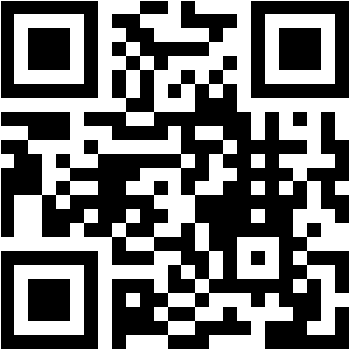
https://www.menti.com/3fa7smmyg3
43 32 25 4

Slide 13
Digital resources to enhance collaboration skills?
Selwyn Griffith

Slide 14
Google for Education
Google Docs
Google Sheets
Google Slides
Classroom
Drive
Jamboard

Slide 15
Virtual WhiteBoard

Slide 16
Vídeo Calls

Slide 18
Virtual team building has the power to make remote teams feel as tight-knit as on-site teams. This is especially true if you leverage purpose, vision, and enthusiasm to plan crowd-pleasing virtual team building activities.
By Ashley Bell

Slide 19
What Are Teamwork Skills?
Regardless of your role, you need to be able to work well with others and convey your teamwork skills to hiring managers, recruiters, and prospective employers. Scan any job listing, and you’ll see that even ads that seek “self-starters” also inevitably use the phrase “team player.” Those who have teamwork skills like communication and a positive attitude can help a team be more productive.

Slide 20
Open Mic Virtual Icebreaker
Time: About 10 minutes
How-to:
Give everyone a heads up that they will have about a minute at the beginning of the meeting to take the virtual stage.
Ask them to find or write an icebreaker joke, read a poem, sing a song, play the mandolin—anything they want!
Start your meeting with these glorious performances.
Allow ten seconds in between each for a rush of snaps and applause.

Slide 21
2. Think-Pair-Share
The think-pair-share technique is a classroom collaborative learning staple that instructors can easily reproduce online. Students work together in pairs to analyze, evaluate, or synthesize a topic and then share their findings with the rest of the class.
To enact the think-pair-share technique, you have to — you guessed it — pair off students (groups of three also work). The instructor poses a question at the end of class; before the next session, the groups meet and discuss their responses. The question should be open-ended to provoke thoughtful discussion. Then ask the students to share their answers either during class or on a discussion board thread.

Slide 22
Think-Pair-Share
Having students talk through their answers with another person before bringing them to the class boosts the quality of the discussion. Unlike in a traditional classroom where only volunteers who raise their hands get to participate, every person in the class gets a chance to reflect and share with another person.

Slide 23
Some other activities that can promote collaboration are:
1. Jigsaw Technique
2. Brainwriting
3. Daily Discussion Questions
4. Break-Out Group Discussions
5. Peer Review
6. Scaffolding

Slide 24
What are some collaboration skills that you look for when working within a team?

Slide 25
In one word, what did you learn today?
menti.com
code: 34 48 99 7

Slide 26
Resources:
The Power of Teacher Collaboration https://www.teachingchannel.com/blog/teacher-collaboration
Ten Strategies to Build Student Collaboration in Classroom https://gsehd.gwu.edu/articles/10-strategies-build-student-collaboration-classroom
Deeper Learning: A Collaborative Classroom Is Key https://www.edutopia.org/blog/deeper-learning-collaboration-key-rebecca-alber
Video: The Deep Dive: ABC Nightline - IDEO Shopping Cart (2009)
https://www.youtube.com/watch?v=M66ZU2PCIcM
Collaborating Learning https://teaching.cornell.edu/teaching-resources/engaging-students/collaborative-learning
20 Collaborative Learning Tips and Strategies for Teachers (image)
https://www.teachthought.com/pedagogy/20-collaborative-learning-tips-and-strategies/
Seven Online Collaborative Learning Strategies to Keep Students Engaged While At Home
https://www.eduflow.com/blog/online-collaborative-learning-strategies-to-keep-students-engaged-while-at-home
Collaboration Skills: https://www.youtube.com/watch?v=qi9nVpc9gq4
https://www.gettingsmart.com/2019/10/5-ways-to-build-collaborative-learning-skills-in-and-out-of-the-classroom/

Slide 27
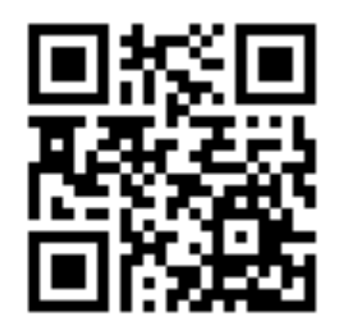
Please answer this questionnaire
http://gg.gg/n1r2s

Slide 28
“ . . . communication and shared identity within a team can mediate the effects of physical separation.”

