Slide 1
Digital Transformation of Public Health Accelerating the adoption of new paradigms across the Americas
DECEMBER, 2020
Marcelo D’Agostino
Sr. Advisor, Information Systems and Digital Health Department of Evidence and Intelligence for Action in Health Office of the Assistant Director

Slide 2
Digital transformation for health means positioning the public health sector at the vanguard of the age of digital interdependence
Digital transformation for PAHO means positioning the Organization at the vanguard of the age of digital interdependence
Not simply digitizing or utilizing more hardware and software in health care delivery or in PAHO’s activities.
It requires high-level commitments to improve and use data-driven solutions under new guiding principles and with renewed competencies.
What are we talking about ?

Slide 3
Strategic Visioning Model
Lessons learned
Knowledge application
Decision making
Policy making
What are we talking about ?
Implementation Research
Knowledge translation
Data gathering
Data modelling
Digital solutions
Digital principles
Prioritization
Technical guidance
Informed decisions
Knowledge creation
Country offices
Technical Programs

Slide 4
Public Health in the age of Digital Interdependence
1
Achieving universal connectivity for the health sector by 2030
5
Ensuring the protection of human rights within digital health
2
Promoting digital health public goods (DPHG) to create a more equitable world
6
Supporting global cooperation on artificial intelligence and any emerging technology
3
Ensuring digital health inclusion for all, considering the most vulnerable
7
Promoting trust and information security in the public health digital environment
4
Strengthening information systems and digital health (capacity-building)
8
Building a more effective public health architecture for digital cooperation
Adapted from UN Roadmap for Digital Cooperation: https://www.un.org/en/content/digital-cooperation-roadmap
Accelerating the adoption of new paradigms in PAHO and across the Americas

Slide 5
Millions of people around the world are quarantined or in physical isolation, with border closings and restrictions in travel, Information Technologies (IT) have become the main means of interaction and communication.
Suddenly, Digital Health and related concepts have begun to appear in every conversation related to the Health Systems’ response to the pandemic.
And despite being longstanding concepts, the current situation has elevated them to the forefront of all discussions and decision-making about the pandemic response
There is now the UN Secretary-General Roadmap for Digital Cooperation
Why now?

Slide 6
Move from the evolution of technologies to the revolution of “users” of technologies
Join countries in their ongoing processes of digital transformation of governments
Support the ministries of health to position themselves in these movements that respond to national policies and priorities
Accelerate our response by adopting a new framework for technical cooperation, including reengineering of processes, standards, skills and technological infrastructure
Position PAHO as the leading agency for implementing the UN Roadmap for Digital Cooperation customized for Health
Conduct a future state vision exercise at PAHO to collectively define the path
What should we do?

Slide 7
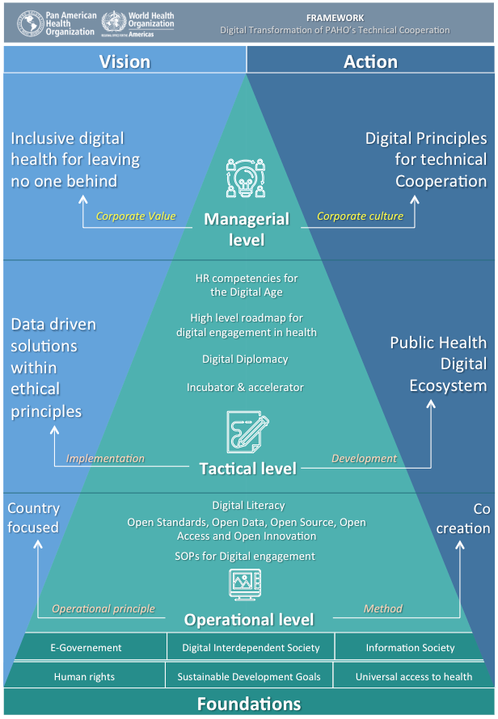
Framework
Managerial Level (EXM)
Corporate value
Digital principles
Global alignment
Tactical Level (All managers)
Digital competencies
Digital diplomacy
Knowledge Management
Prioritization
Operational level (All entities)
TC Incubator and accelerator
Corporate Data Driven platform
Corporate platforms for digital cooperation
Digital literacy Program
Digital policies
SOPs for Digital engagement
Who should participate (PAHO) and how?

Slide 8
MoHs
UN agencies
Who should participate (Partners)?
Telecoms
YOU
PAHO
Academia
IT sector
NGOs

Slide 9
Prioritize new technical cooperation needs
Digital Transformation in Health
Incorporation of “non traditional areas” for public health such as:
Artificial Intelligence
Contact tracing / contact proximity APPs
Chatbots
Blockchain technology
Robotics
Remote communications platforms
Innovation of health systems
Critical data management (Open Government Portals)
Modernization of legal instruments for accelerating the adoption of digital health solutions (example Telemedicine)
Renewed skills for human resources (PAHO Staff and Health Workers)
Knowledge Management strategies
How to innovate and accelerate the process?

Slide 10
Digital principles for technical cooperation
1
What are the leading factors for success?
Renewed & more efficient technical cooperation
Renewed competencies map
2
Ongoing Knowledge Management, Digital Literacy and Digital Diplomacy Programs
3
Country focused & People centered

Slide 11
Guiding questions for Managers and teams by thinking 'outside' own experiences and expertise
How would collaboration look like in a digital world with no constraints (Technical, administrative or legal)?
What would data management process look like in a region 100% operating with open datasets available on-line?
Should any of the current tasks (Administrative or technical) be performed by someone else? Would there be better value added?
What ideas does your entity have to create a different future for PAHO in the Age of Digital Interdependence?
What would you like to see different after positioning your entity in the Age of Digital Interdependence?
Identify obstacles or challenges in the transition from the current state to the future state of Health Sector transformed to the Digital Age (Technical, administrative or legal)
How to envision the future at all levels ?

Slide 12
To reposition a renewed vision for Knowledge Management at all levels of Public Health interventions
New ways of looking at lessons learned
What’s next?
Digital literacy from early education
New ways of implementing After Actions Reviews
KM into open data & open government principles

Slide 13
Thank you
Marcelo D’Agostino
Sr. Advisor, Information Systems and Digital Health Department of Evidence and Intelligence for Action in Health Office of the Assistant Director
@marcelodagos

